Slide 1
Hyperledger Fabric a Distributed Operating System for Permissioned Blockchains
Marko Vukolić, IBM Research - Zurich
February 1, 2018
TU Delft
Blockchain Lab Launch

Slide 2





What is a Blockchain?
A chain (sequence, typically a hash chain) of blocks of transactions
Each block consists of a number of (ordered) transactions
Blockchain establishes total order of transactions
#0
Genesis block
#1
…
#234
#235
#236
datastructure
Consensus protocol ensures ledger replicas are identical*
Node F
Node A
Ledger
Ledger
Node E
Ledger
Node B
Node D
Ledger
Ledger
Ledger
Node C
Network of
untrusted nodes

Slide 3



Blockhain transactions and distributed applications
Bitcoin transactions
simple virtual cryptocurrency transfers
Transactions do not have to be simple nor related to cryptocurrency
Distributed applications
smart contracts (Ethereum) or chaincodes (Hyperledger Fabric)
A smart contract is an event driven program, with state,
which runs on a replicated, shared ledger [Swanson2015]
“Smart contract” → (replicated) state machine

Slide 4
So we can just apply 40 years of research on RSM?
RSM = Replicated State Machines [Lamport 78, countless follow-up papers]
Well, not really…
Among other differences
RSM approach
single trusted application
Blockchain smart-contracts
Multiple applications
Not (necessarily) trusted!
Developed by third party application developers

Slide 5

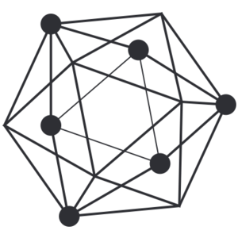
Blockchain evolution (2009-present)
A hard-coded cryptocurrency application
w. limited stack-based scripting language
Proof-of-work-consensus
Native cryptocurrency (BTC)
Permissionless blockchain system
2009
Bitcoin
Blockchain 1.0
Distributed applications (smart contracts)
in a domain-specific language (Solidity)
Proof-of-work-consensus
Native cryptocurrency (ETH)
Permissionless blockchain system
2014
Ethereum
Blockchain 2.0
2017
Hyperledger
Fabric
Distributed applications (chaincodes)
in different general-purpose languages
(e.g., golang, Java, Node)
Modular/pluggable consensus
No native cryptocurrency
Multiple instances/deployments
Permissioned blockchain system
Blockchain 3.0

Slide 6
Blockchain follows order-execute architecture
Order transactions using Proof-of-Work(POW) or BFT consensus
Execute transactions at each node
Order/ Execute architecture is found in many SMR systems - Active state machine replication
- Paxos and vast majority of BFT.

Slide 7
Permissionless Blockchains
A =hash of block #236
B = Root hash of
Merkle tree of tx
hashes
C = nonce
Block #237
Transactions
(payload)
Step1:PoW Block “mining”
Step2: Gossip Block #237 across the network
Step3:Execution (tasks of every miner)
Executing transactions in the block
Verify hash of Block #237 < DIFFICULTY
…
#234
#235
#236
ORDER→ EXECUTE architecture
Nodes execute smart-contracts after consensus (PoW)
Validating (executing) transactions in the payload
Finding nonces such that
h = hash of Block #237 = SHA256(A||B||C) < DIFFICULTY
Miner of block #237
A =hash of block #236
B = Root hash of
Merkle tree of tx
hashes
C = nonce
Block #237
Transactions
(payload)
…
#234
#235
#236

Slide 8
Permissioned Blockchain 2.0 architecture
Seq #24
View no
Tx1
Tx3
Tx2
Tx4
Node A (leader)
Node B
Node C
Node D
example:
PBFT [Castro/Liskov02]
…
#234
#235
#236
Seq #24
View no
Tx1
Tx3
Tx2
Tx4
Execute tx

Slide 9

Hyperledger Fabric – key requirements
No native cryptocurrency
Ability to code distributed apps in general-purpose languages
Modular/pluggable consensus
Satisfying these requirements required
a complete overhaul of the (permissioned) blockchain design!
end result
Hyperledger Fabric v1
http://github.com/hyperledger/fabric
Open source, Apache 2.0 license

Slide 10
What are the issues with
ORDER → EXECUTE
architecture?

Slide 11

ORDER → EXECUTE architecture issues (Blockchain 2.0)
Sequential execution of smart contracts
long execution latency blocks other smart contracts, hampers performance
DoS smart contracts (e.g., infinite loops)
How Blockchain 2.0 copes with it:
Gas (paying for every step of computation))
Tied to a cryptocurrency
Non-determinism
Smart-contracts must be deterministic (otherwise – state forks)
How Blockchain 2.0 copes with it:
Enforcing determinism: Solidity DSL, Ethereum VM
Cannot code smart-contracts in developers favorite general-purpose language (Java, golang, etc)
Inflexible consensus: Consensus protocols are hard-coded
Confidentiality of execution: all nodes execute all smart contracts

Slide 12
HLF v1 architecture in one slide
Existing blockchains’ architecture
input tx tx against smart contracts
Hyperledger Fabric v1 architecture
EXECUTE → ORDER → VALIDATE
Application consists of two components:
Chaincode (execution code)
Endorsement policy (validation code)

Slide 13
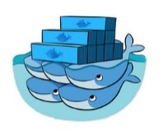

Hyperledger Fabric v1 Transaction flow
Total order semantics
(ordering service)
1
<PROPOSE, clientID, chaincodeID, txPayload, timestamp, clientSig>
3
BROADCAST(blob)
2
<TX-ENDORSED, peerID, txID, chaincodeID, readset, writeset>
4
DELIVER(seqno,prevhash,block)
1
docker local database
Collect endorsement
(“sufficient” no. of
TX-ENDORSED Msgs)
Simulate/Execute tx
Sign TX-ENDORSED
2
broadcast(endorsement)
Ordering service (consensus)
3
4
client (C)
endorsing
peer (EP1)
endorsing
peer (EP2)
endorsing
peer (EP3)
orderers

Slide 14
Hyperledger Fabric v1 Transaction flow
Total order semantics
(ordering service)
1
<PROPOSE, clientID, chaincodeID, txPayload, timestamp, clientSig>
3
BROADCAST(blob)
2
<TX-ENDORSED, peerID, txID, chaincodeID, readset, writeset>
4
DELIVER(seqno,prevhash,block)
1
docker local database
Collect endorsement
(“sufficient” no. of
TX-ENDORSED Msgs)
Simulate/Execute tx
Sign TX-ENDORSED
2
broadcast(endorsement)
Ordering service (consensus)
3
4
4
client (C)
endorsing
peer (EP1)
endorsing
peer (EP2)
endorsing
peer (EP3)
(committing)
peer (CP4)
(committing)
peer (CP5)
orderers

Slide 15
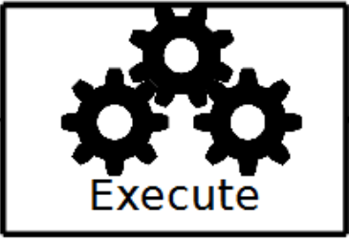
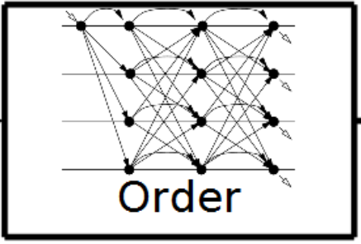
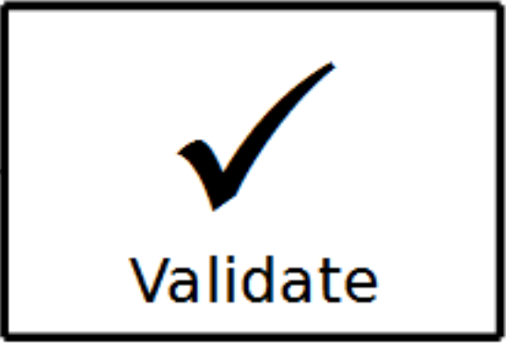
Hyperledger Fabric v1 Transaction flow
Total order semantics
(ordering service)
1
<PROPOSE, clientID, chaincodeID, txPayload, timestamp, clientSig>
3
BROADCAST(blob)
2
<TX-ENDORSED, peerID, txID, chaincodeID, readset, writeset>
4
DELIVER(seqno,prevhash,block)
1
docker local database
Collect endorsement
(“sufficient” no. of
TX-ENDORSED Msgs)
Simulate/Execute tx
Sign TX-ENDORSED
2
Sufficiently enough to satisfy
Endorsement
Policy (EP)
Ordering service (consensus)
3
4
4
Validate(endorsement,
chaincodeID,
EP)
Validate(readset)
Commit tx
Validate(endorsement,
chaincodeID,
EP)
Validate(readset)
Commit tx
client (C)
endorsing
peer (EP1)
endorsing
peer (EP2)
endorsing
peer (EP3)
(committing)
peer (CP4)
(committing)
peer (CP5)
orderers
local database

Slide 16
Distributed applications in Fabric
Excution code (a.k.a chaincode)
Execute untrusted chaincode before consensus
Non-deterministic chaincode execution is tolerated
EXECUTE→ORDER→VALIDATE: non-deterministic tx
are not guaranteed to be live
ORDER→ EXECUTE:non-deterministic tx are not guaranteed to be safe (forks can occur)
Validation code (a.k.a endorsement policy)
Deterministic (!) executed post-consensus
Deployed by a set of administrators(e.g., majority of nodes on the network)
Instantiated by chaincode
Examples
K out of N chaincode endorsers need to endorse a tx
Alice OR (Bob AND Charlie) need to endorse a tx
Fabcoin – Bitcoin-inspired UTXO authority-minted cryptocurrency for Fabric
Customized validation code

Slide 17
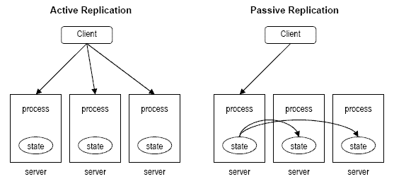
Distributed applications in Fabric
Excution code (a.k.a chaincode)
Execute untrusted chaincode before consensus
Non-deterministic chaincode execution is tolerated
EXECUTE→ORDER→VALIDATE: non-deterministic tx
are not guaranteed to be live
ORDER→ EXECUTE:non-deterministic tx are not guaranteed to be safe (forks can occur)
Validation code (a.k.a endorsement policy)
Deterministic (!) executed post-consensus
Deployed by a set of administrators(e.g., majority of nodes on the network)
Instantiated by chaincode
Examples
K out of N chaincode endorsers need to endorse a tx
Alice OR (Bob AND Charlie) need to endorse a tx
Fabcoin – Bitcoin-inspired UTXO authority-minted cryptocurrency for Fabric
Fabric mixes
passive and active replication
into hybrid replication

Slide 18
Consensus modularity/pluggability
Goal
No-one-size-fits-all consensus → Consensus protocol must be modular and pluggable
Fabric consensus (ordering service) implementations, Nov 2017
Centralized! (SOLO, mostly for development and testing)
Crash FT (KAFKA, thin wrapper around Kafka/Zookeeper)
Proof of concept BFT
BFT-SMaRt library (University of Lisbon, September 2017)
Code: https://github.com/jcs47/hyperledger-bftsmart
Paper: https://arxiv.org/abs/1709.06921
«Native» BFT implementation targeting about 100 orderers – in progress
Many more to come (TBC)
Production-ready BFT later this year
Hybster SGX Consensus (TU Braunschweig, Eurosys 2017), Honeybadger BFT (UIUC, CCS’16, Stanford), XFT (IBM, OSDI’16)
Perhaps also your new, great blockchain consensus?

Slide 19
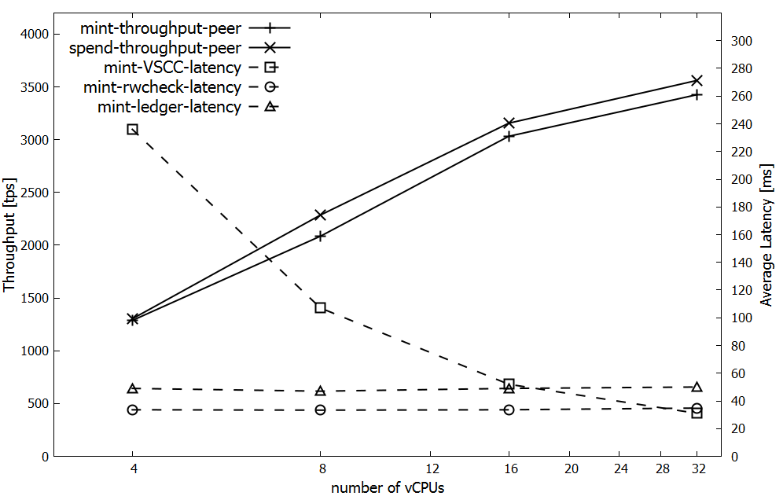
Fabric/Fabcoin performance

Slide 20
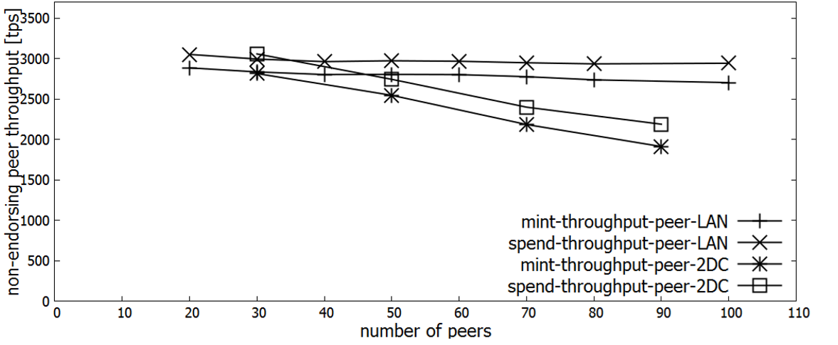
Fabric/Fabcoin performance
5 datacenter experiments in this paper

Slide 21































Over 400 prototypes, engagements and multiple active networks
Trade Finance | Pre and Post Trade | Complex Risk Coverage
Identity/ Know your customer (KYC) | Unlisted Securities/ Private Equity Funds | Loyalty Program
Medicated Health Data Exchange | Fraud/ Compliance Registry | Distributed Energy/ Carbon Credit
Supply Chain | Food Safety | Provenance/ Traceability
Notes:
IBM brings the experience of over 400+ Client engagements and multiple active networks at your ecosystems fingertips.
The IBM Blockchain Platform puts the experience of over 400+ Client engagements and multiple active networks at your ecosystems fingertips.
IBM has a large and increasing number of public references on blockchain.
COMPLETE LIST with references is here > http://ibm.biz/BlockPubRef
Northern Trust:
http://www-03.ibm.com/press/us/en/pressrelease/51655.wss
Maersk:
http://www-03.ibm.com/press/us/en/pressrelease/51712.wss
HSBC, Bank of America, IDA:
http://www.coindesk.com/hsbc-bank-america-blockchain-supply-chain/
ABN AMRO:
https://www.abnamro.com/en/newsroom/blogs/arjan-van-os/2016/walking-the-walk-exploring-the-power-of-blockchain.html
Crédit Mutuel Arkéa:
http://www.coindesk.com/ibm-completes-blockchain-trial-french-bank-credit-mutuel/
JPX:
http://www.ibm.com/press/us/en/pressrelease/49088.wss
Kouvola Innovation:
http://www.ibm.com/press/us/en/pressrelease/49029.wss
London Stock Exchange:
http://www.ibtimes.co.uk/linux-foundation-blockchain-consortium-digital-asset-ibm-credits-london-stock-exchange-board-1533798
Mizuho:
http://www.coindesk.com/mizuho-digital-currency-powered-blockchain-settlement/
IBM Global Finance:
http://www.coindesk.com/ibm-building-blockchain-dispute-resolution-system/
Everledger
https://www-03.ibm.com/press/us/en/pressrelease/50169.wss
Bank of Tokyo Mitsubishi
https://www-03.ibm.com/press/us/en/pressrelease/50544.wss
China UnionPay
http://www.coindesk.com/ibm-china-unionpay-blockchain-loyalty-exchange/
CLS
http://www.coindesk.com/cls-to-develop-blockchain-payment-service-on-ibm-fabric/
UBS
http://www.coindesk.com/ubs-blockchain-prototype-trade/
IBM GF: http://www.coindesk.com/ibm-building-blockchain-dispute-resolution-system/

Slide 22
Thank You!

